Slide 1

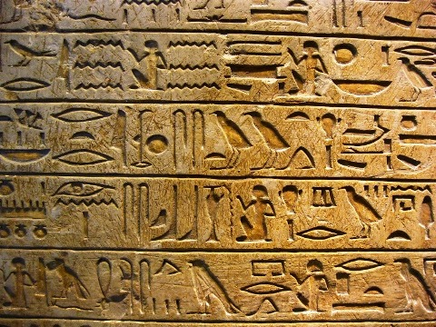
Protection of Traditional Knowledge

Slide 2
01
Traditional Knowledge
02
Need to Protect It
Table of contents
03
Significance
04
Value in Global Economy
05
U-Turn Theory
06
TKDL

Slide 3

“You can predict the future of any country merely by looking at the roots of its traditional knowledge.”

Slide 4
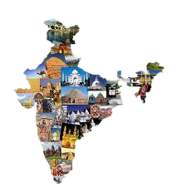
01
Traditional Knowledge
What is traditional knowledge?

Slide 5
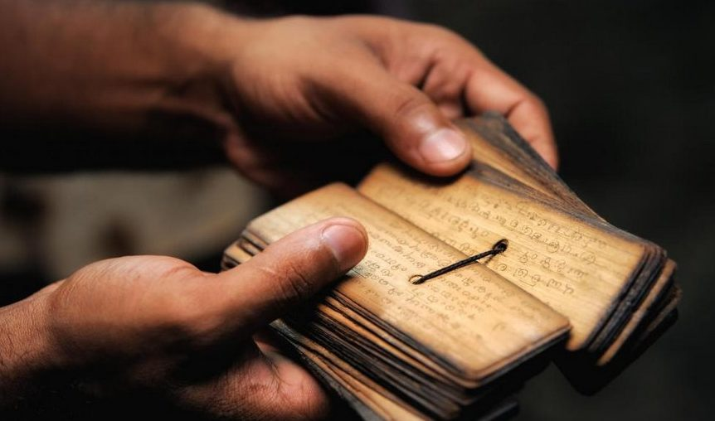
Overview
Traditional Knowledge (TK) can be said to be the skills, ideas and knowledge that is passed within any community, generation after generation, causing to form spiritual and cultural identity.
For instance, agricultural and medical knowledge

Slide 6
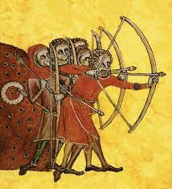
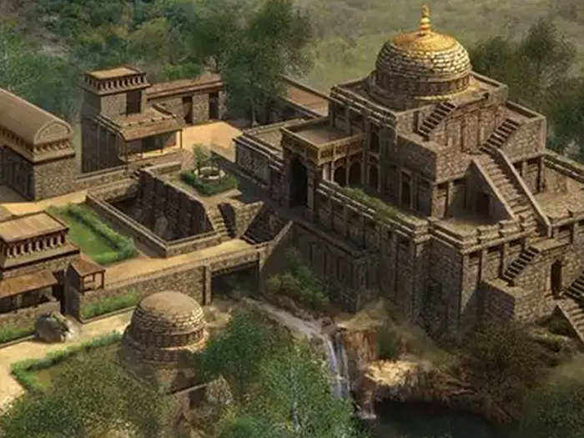
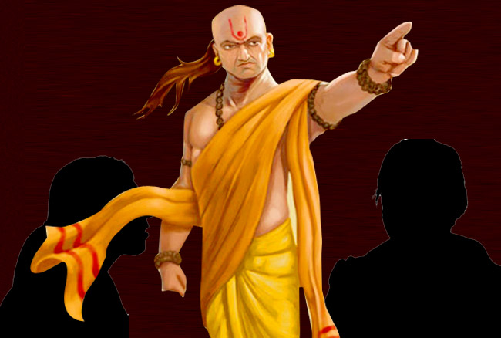
Universities
Nalanda
and
Takshila
Taught 50+ courses
Largest library (over 9 million books)
Great students like Chanakya

Slide 7
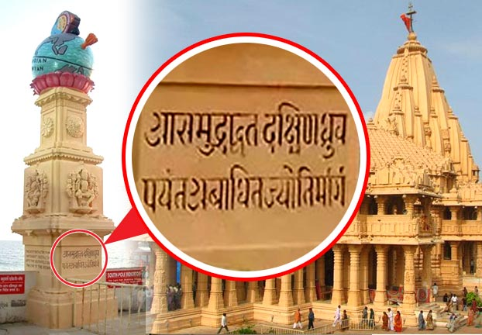
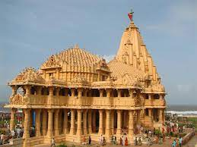
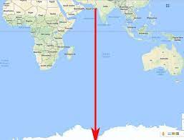
Somnath
Mystery of ‘Baan Stambh’
Built 2000 years ago
No advanced technology

Slide 8
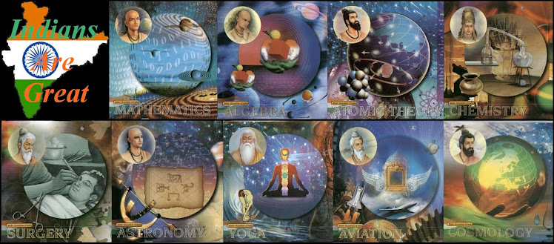
02
Significance

Slide 9
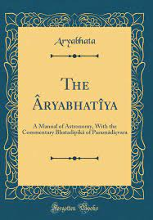
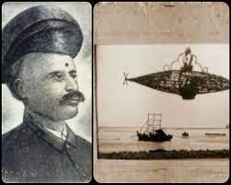
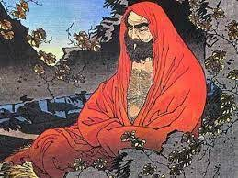
Some forgotten heroes
Aryabhatiyam
Shivkar Talpade
Bodhidharma
Book written by Aryabhata mentioning gravity
Man, who invented airplane 8 years before Wright brothers
Bodhidharma was a legendary Buddhist monk

Slide 10

03
Global Economy

Slide 11
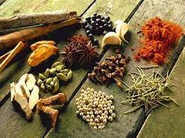
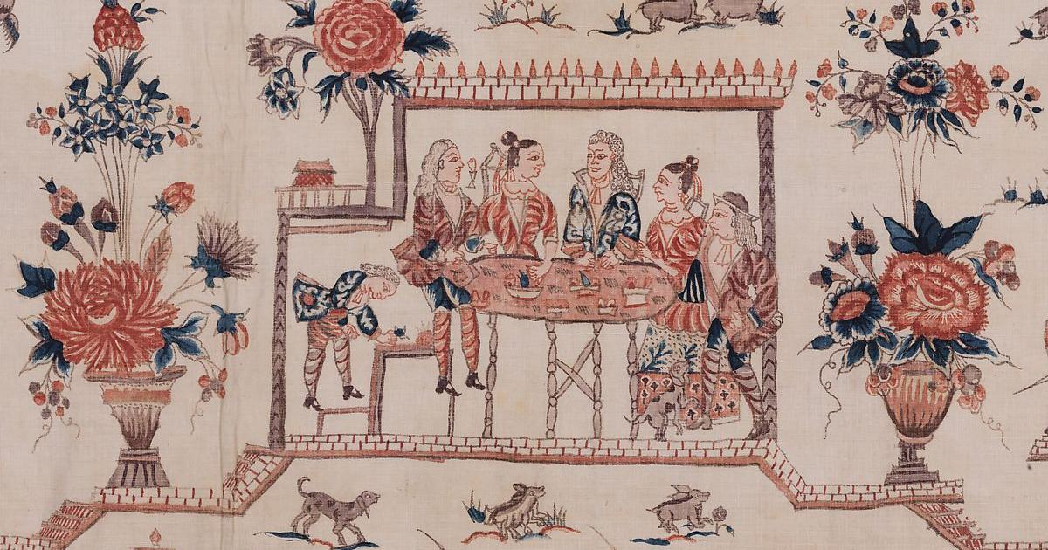
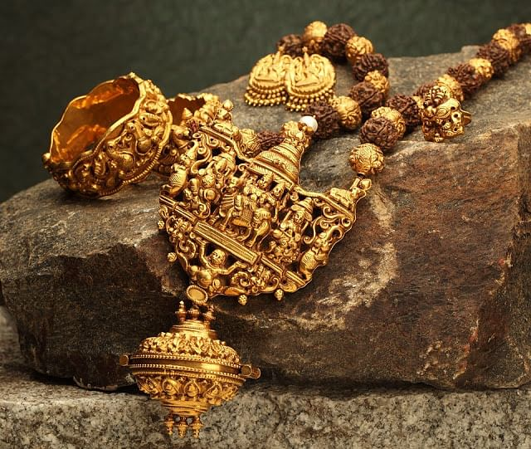
Indian traditional things hold a great position globally.
Spices and Herbs
Fabrics
Craft work

Slide 12

04
U Turn Theory

Slide 13
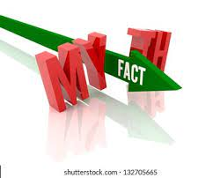
Is Westernization = Modernization ?
Farming
Gestures
Toilets
Yoga
Organic farming is best.
Back to Namaste
Indian toilets are scientifically correct
Getting mor popular
in western land

Slide 14

05
TKDL
Traditional Knowledge Digital Library

Slide 15

Key Features
Data
Network
Information
Bio-Piracy
A database containing 34 million pages
Access and agreements with the Indian and seven global patent offices
Managed to protect around 0.226 million medicinal formulations, that too at zero direct cost!
Contains 2,260,000 medicinal formulations in multiple languages

Slide 16


THANK YOU !

